Slide 1


Unit 01 : Programming Introduction to Algorithms
Presented By :
Mohammed mohammed islam

Slide 2
TABLE OF CONTENTS
01
02
03
04
05
06
Introduction
What is An Algorithm
ALGORITHM FEATURES
Algorithm vs. Program
Flowcharts Symbols
Types of Algorithms
07
08
09
Characteristics of Algorithms
Process of translation
Paradigm

Slide 3
Introduction
Al Khawarezmi was
the creator of algorithms.

Slide 4
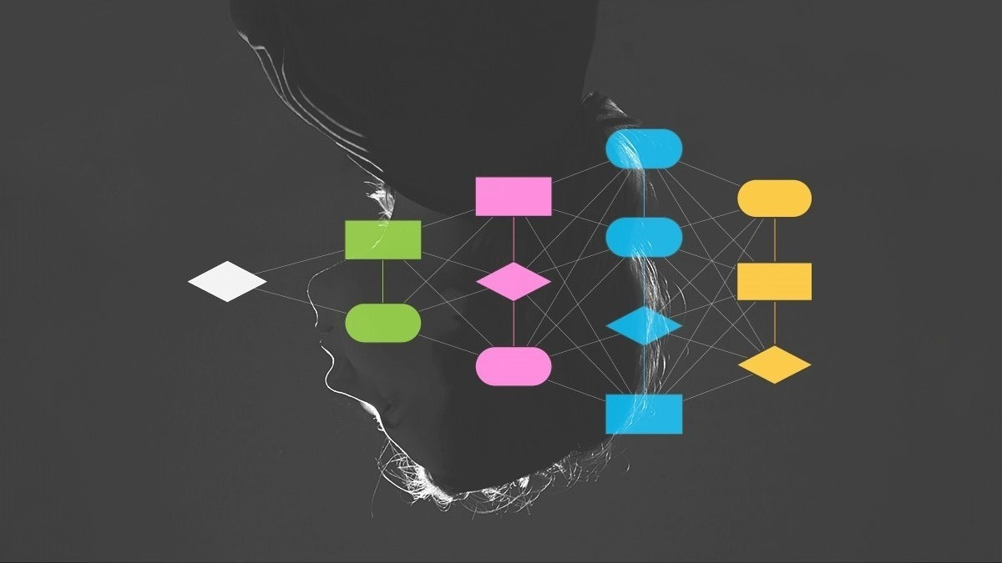
01
What is An Algorithm
ALGORITHMS
An algorithm is a procedure used for solving a problem or performing a computation. Algorithms act as an exact list of instructions that conduct specified actions step by step in either hardware- or software-based routines.

Slide 5
ALGORITHM FEATURES :
Clear and Unambiguous: when you want to indicate that something is easily understood and not open to misinterpretation.
Well-Defined Inputs: ensure that the algorithm's behavior is deterministic, which means, that the same input will always produce the same output.
Well-Defined Outputs: The algorithm must clearly define what output will be yielded and it should be well-defined as well.
Finiteness: An algorithm must always terminate after a finite number of steps.
Feasible: In order to be executed with the resources at hand, the algorithm must be straightforward, general, and workable. It must not include anything or any technology from the future.

Slide 6


Algorithm vs. Program
Computer program:
Written in a programming language
Implements an algorithm.
Algorithm:
Written in natural language
Solves a problem.

Slide 7
Flowcharts Symbols
Arrows
Process
The arrow is a connector shows the direction and order of the process.
Rectangle represents a process.
The oval, or terminator symbol.
Parallelogram is used to show input or output.
A diamond represents a decision.
Start/End
Input/output
Decision

Slide 8
Characteristics of Algorithms
Output
Input
An algorithm has one or more outputs, which have a specified relation to the inputs.
Unambiguity
An algorithm has zero or more inputs, taken from a specified set of objects.
lack of ambiguity : possession of one clear meaning.
Effectiveness
All operations to be performed must be sufficiently basic that they can be done exactly and in finite length.
Finiteness
independence
The algorithm must always terminate after a finite number of steps.
instructions can be implemented in any language and produce the same results.

Slide 9
Types of Algorithms
Sorting algorithms
Searching algorithms
Graph Algorithms
a set of instructions that take an array or list as an input and arrange the items into a particular order.
designed to check for an element or retrieve an element from any data structure where it is stored.
a set of instructions that traverse (visits nodes of a) graph.

Slide 10
Sorting algorithms
Selection Sort
Bubble Sort
an effective and efficient sort algorithm based on comparison operations. It adds one element in each iteration. You need to select the smallest element in the array and move it to the beginning of the array by swapping with the front element.
Bubble Sort is the simplest sorting algorithm that works by repeatedly swapping the adjacent elements if they are in the wrong order. This algorithm is not suitable for large data sets as its average and worst-case time complexity is quite high.

Slide 11
Algorithm of Selection sort
Step 1: The algorithm starts by considering the entire list as unsorted.
Step 2: Find the Minimum: It then searches for the minimum element in the unsorted part of the list.
Step 3: Once the minimum element is found, it is swapped with the first element of the unsorted part.
Step 4: The boundary between the sorted and unsorted parts is moved one position to the right.
Step 5: Steps 2–4 are repeated until the entire list becomes sorted.

Slide 12
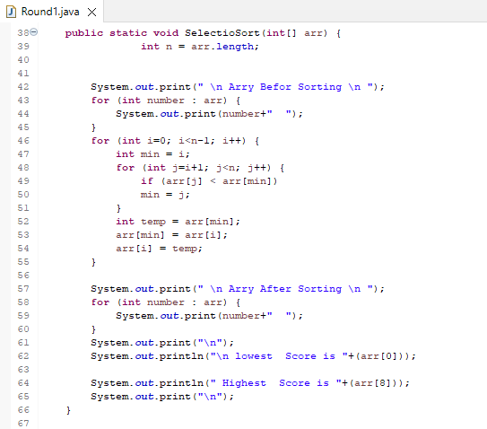
Selection Sort method

Slide 13
Algorithm of bubble sort
Step 1: Start by comparing the first two elements of the list.
Step 2: If the first element is greater than the second element, swap them.
Step 3: Move to the next pair of elements (the second and third elements), and repeat the comparison and swapping process.
Step 4: Continue this process until you reach the end of the list. By this point, the largest element will have “bubbled up” to the end of the list.
Step 5: Repeat steps 1–4 for the remaining elements, excluding the last element since it is already in its correct position.
Step 6: Repeat the entire process for a decreasing range of elements until the entire list is sorted.

Slide 14
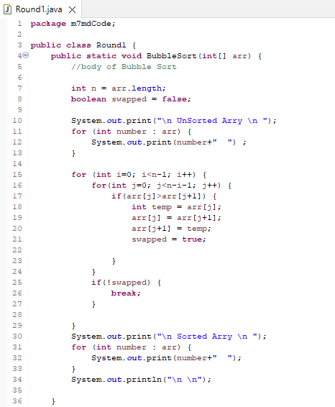
Bubble Sort method

Slide 15
Searching algorithms
Linear Search
a sequential search algorithm that starts at one end and goes through each element of a list until the desired element is found, otherwise the search continues till the end of the data set.

Slide 16
Algorithm of Linear Search
Step 1: First, read the search element (Target element) in the array.
Step 2: In the second step compare the search element with the first element in the array.
Step 3: If both are matched, display "Target element is found" and terminate the Linear Search function.
Step 4: If both are not matched, compare the search element with the next element in the array.
Step 5: In this step, repeat steps 3 and 4 until the search (Target) element is compared with the last element of the array.
Step 6: If the last element in the list does not match, the Linear Search Function will be terminated, and the message "Element is not found" will be displayed.

Slide 17
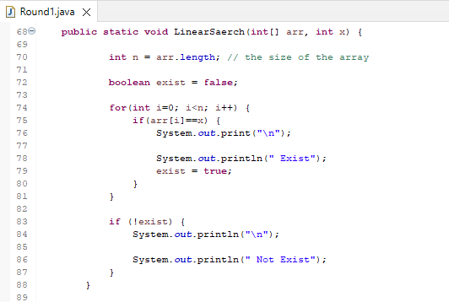
Linear Search method

Slide 18
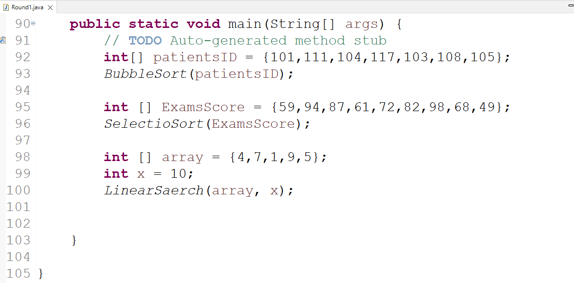
Main mathod

Slide 19
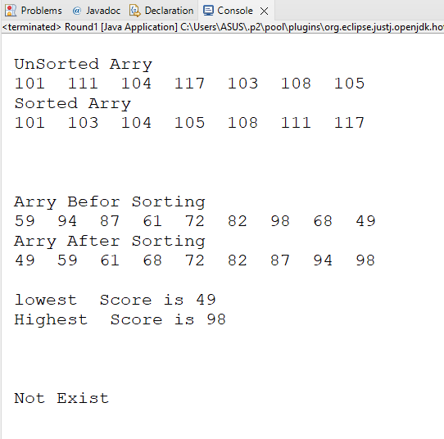
execution

Slide 20
How dose computer understand programming
Computers understand programming languages through the use of translation such as compilers, interpreters, assembler and linker.

Slide 21
Process of translation
01
02
03
04
compiler
assembler
An assembler translates assembly language programs into machine code. The output of a assembler is called an object file, which contains a combination of machine instruction as well as the data required to place these intstructions in memory.
is a program that converts the source code written in a programming language into machine code, which can be executed directly by the computer's central processing unit.
interpreter
linker
An interpreter, on the other hand, reads the source code and executes it line by line, rather than converting it into machine code. Both compilers and interpreters are able to "understand" programming languages by following a set of rules and instructions, known as the language's syntax, to translate the code into a form that the computer can execute.
Linker is a computer program that links and merges various object files together in order to make an executable file. All these files might have been compiled by separate assembler.The major task of a linker is to search and locate referenced module/routines in a program and to determine the memory location where these codes will be loaded making the program instruction to have absolute reference.

Slide 22


Paradigm
Programming paradigms are different ways or styles in which a given program or programming language can be organized. Each paradigm consists of certain structures, features, and opinions about how common programming problems should be tackled.

Slide 23
Programming paradigms
IMPERATIVE
DECLARATIVE
PROCEDURAL PRAGRAMMING
LOGIC PRAGRAMMING
OBJECT ORIENTED PRAGRAMMING
FUNCTIONAL PRAGRAMMING
EVENT DRIVEN PROGRAMMING
DATABASE PROCESSING APPROACH

Slide 24
Programming paradigms
Procedural programming is a programming paradigm, derived from imperative programming, based on the concept of the procedure call. Procedures (a type of routine or subroutine) simply contain a series of computational steps to be carried out.
PROCEDURAL PRAGRAMMING
Programming paradigms
OBJECT ORIENTED PROGRAMMING
Object-oriented programming (OOP) is a programming paradigm based on the concept of objects, which can contain data and code: data in the form of fields (often known as attributes or properties), and code in the form of procedures (often known as methods).
EVENT DRIVEN PROGRAMMING
Event-driven programming is the dominant paradigm used in graphical user interfaces applications and network servers. In an event-driven application, there is generally an event loop that listens for events and then triggers a callback function when one of those events is detected.

Slide 25
Relationship between procedural, object oriented and event driven programming
The relationship between Procedural programming and object-oriented programming
Procedural programming is type of programming language which deals with function only. Object oriented programming is the latest version of procedural programming. OOP was introduced to overcome the limitation of POP.
The main difference between them is that POP divides many functions to solve problem whereas OOP divides program inti multiple objects.Also, Event driven programming is the computer programming in which flow of program is determined by events like user actions mouse clicks, key press, message from program etc. and object programming language is the software design in which object is defined.
The relationship between event driven programming and object-oriented programming
They can be used together because they are orthogonal.
They operate with same principles like encapsulation, polymorphism, and inheritance. Suresh Programming.
In OOP and EDP objects acquire some mechanism of publishing events, notification and subscribing event notification from other objects.
And most of event driving languages is object oriented. The object waits the event. At some extent the procedure, object oriented, and event driven programming are interrelated with each other because at first in object-oriented programming it is derived from procedural. Procedural uses functions and languages like C++ which also used in object-oriented programming. And in event driven programming it uses event such as notification, messages and outcome which is also similar in object oriented and procedural programming. And they all use loops, data types and structures.

Slide 26


THANKS!
Do you have any questions?
mohammedmohammedislam19@gmail.com
+971 56 22 373 56

